Slide 1





Marketing and Advertising in E-Commerce

Slide 2
Learning Objectives
Describe the factors that influence consumer behavior online.
Understand the decision-making process of consumer purchasing online.
Discuss the issues of e-loyalty and e-trust in electronic commerce (EC).
Describe segmentation and how companies are building one-to-one relationships with customers.
Explain how consumer behavior can be analyzed for creating personalized services.

Slide 3
Learning Objectives
Describe consumer market research in EC.
Describe the objectives of Web advertising and its characteristics.
Describe the major advertising methods used on the Web.
Describe mobile marketing concepts and techniques.
Describe various online advertising strategies and types of promotions.
Describe some implementation topics.

Slide 4


Learning About
Consumer Behavior Online
A MODEL OF CONSUMER BEHAVIOR ONLINE
The Major Influential Factors
Personal Characteristics
Product/Service Factors
Merchant (dealer) and Intermediary Factors
EC Systems
Motivational Factors
Hygiene Factors
Environmental Factors
Social Variables
Cultural/Community Variables
Other Environmental Variables

Slide 5
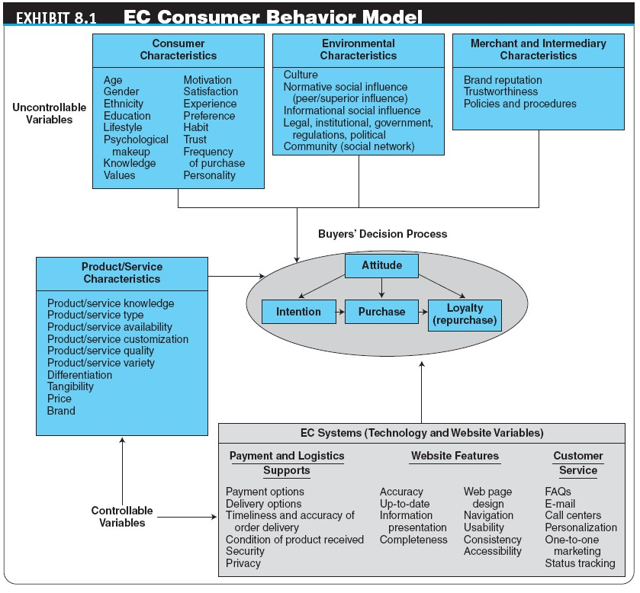

Slide 6

The Consumer Purchasing Decision-Making Process
A GENERIC PURCHASING-DECISION MODEL
Need identification
Information search
product brokering
Deciding what product to buy
merchant brokering
Deciding from whom (from what merchant) to buy a product
Evaluation of alternatives
Purchase and delivery
Postpurchase activities

Slide 7

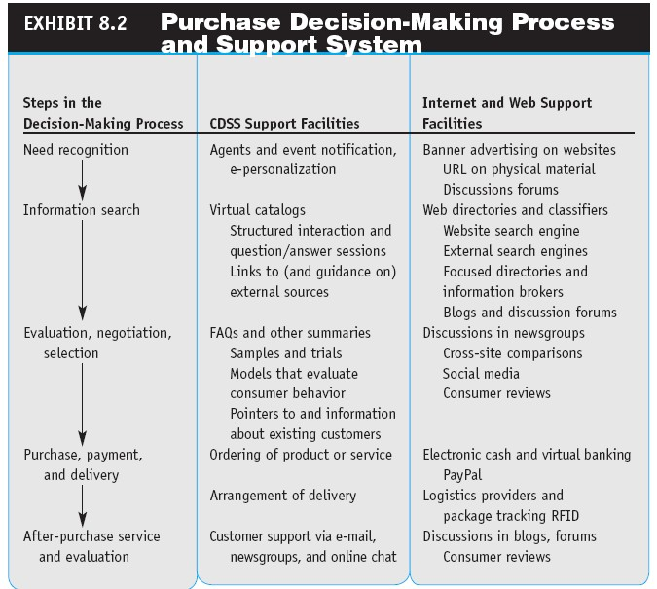

Slide 8
The Consumer Purchasing Decision-Making Process
PLAYERS IN THE CONSUMER DECISION PROCESS
Initiator: first suggests or thinks of idea of buying
Influencer: advice in making a final purchasing decision
Decider
Buyer
User: consumes or uses

Slide 9
Loyalty, Satisfaction,
and Trust in E-Commerce
customer loyalty
A deep commitment to repurchase or repatronize a preferred product/service continually in the future, thereby causing repetitive same-brand or same brand- set purchasing, despite situational influences and marketing efforts that have the potential to cause switching behavior
e-loyalty
Customer loyalty to an e-tailer or loyalty programs
delivered online or supported electronically

Slide 10
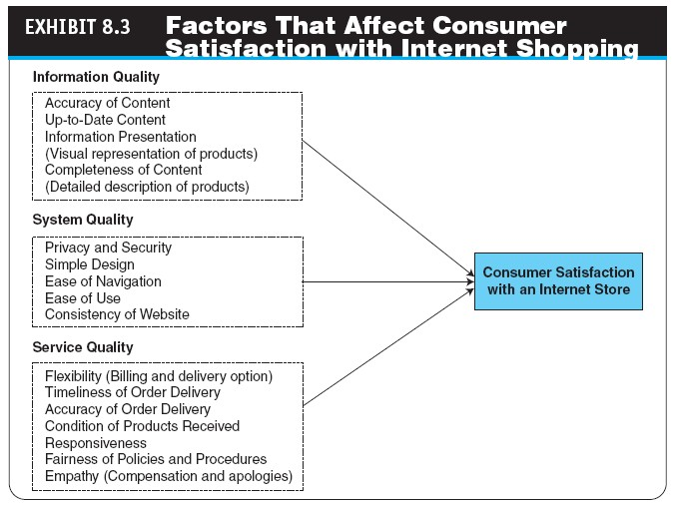

Slide 11

Loyalty, Satisfaction,
and Trust in E-Commerce
TRUST IN EC
trust
The psychological status of willingness to depend on another person or organization
EC Trust Models
online trust
The belief that an online website or other digital entities can deliver what they promise so that the recipient trusts them

Slide 12
Loyalty, Satisfaction,
and Trust in E-Commerce
How to Increase Trust in EC
Improve Your Website
Affiliate (connect) with an Objective Third Party
Establish Trustworthiness
Other Methods for Facilitating Trust
reputation-based systems
Systems used to establish trust among members of online communities where parties with no prior knowledge of each other use the feedback from their peers to assess the trustworthiness of the peers in the community
Online Word of Mouth (feedback, forum…)

Slide 13

Mass Marketing, Market Segmentation, and Relationship Marketing
FROM MASS MARKETING TO ONE-TO-ONE MARKETING
Mass Marketing and Advertising
market segmentation
The process of dividing a consumer market into logical groups for conducting marketing research and analyzing personal information

Slide 14
Mass Marketing, Market Segmentation, and Relationship Marketing
relationship marketing
Marketing method that focuses on building a long-term relationship with customers
one-to-one marketing
Marketing that treats each customer in a unique way

Slide 15
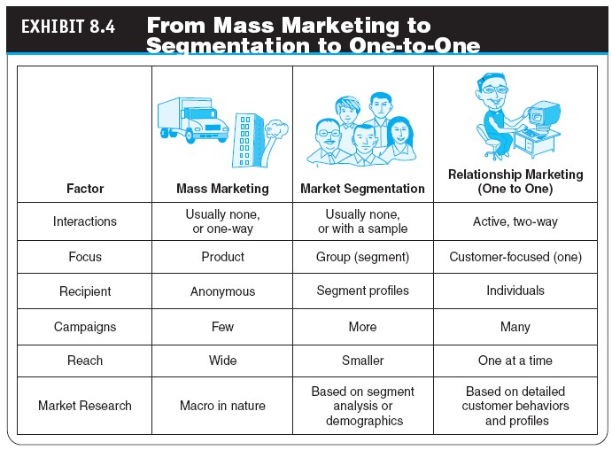

Slide 16
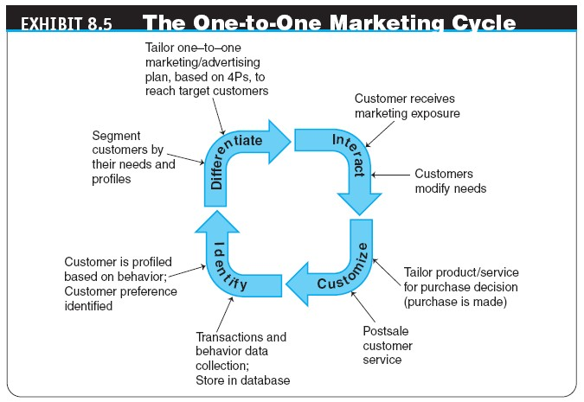


Slide 17
Personalization
and Behavioral Marketing
personalization
The matching of services, products, and advertising content with individual consumers and their preferences
user profile
The requirements, preferences, behaviors, and demographic traits of a particular customer
Notes:
Stop Jun slot 1, 246

Slide 18
Personalization
and Behavioral Marketing
Cookies in E-Commerce
cookie
A data file that is placed on a user’s hard drive by a remote Web server, frequently without disclosure or the user’s consent, which collects information about the user’s activities at a site
Using Personalized Techniques to Increase Sales

Slide 19

Personalization
and Behavioral Marketing
behavioral targeting
Targeting that uses information collected about an
individual’s Web-browsing behavior, such as the pages they have visited or the searches they have made, to select an advertisement to display to that individual
collaborative filtering
A market research and personalization method that uses customer data to predict, based on formulas derived from behavioral sciences, what other products or services a customer may enjoy; predictions can be extended to other customers with similar profiles

Slide 20
Personalization
and Behavioral Marketing
Other Methods
Rule-Based Filtering
Content-Based Filtering
Activity-Based Filtering
Legal and Ethical Issues in Collaborative Filtering
Social Psychology and Morphing in Behavioral Marketing
Use of Customer Database Marketing

Slide 21
Market Research for E-Commerce
OBJECTIVES AND CONCEPTS OF MARKET RESEARCH ONLINE
What Are Marketers Looking For in EC Market Research?
REPRESENTATIVE MARKET RESEARCH APPROACHES
Market Segmentation Research
Data Collection and Analysis
Online Surveys
Hearing Directly from Customers

Slide 22

Market Research for E-Commerce
Data Collection in the Web 2.0 Environment
Observing Customers’ Movements Online
transaction log
A record of user activities at a company’s website
clickstream behavior
Customer movements on the Internet

Slide 23
Market Research for E-Commerce
Web bugs (invisible to the user, checking user has viewed the page or email)
Tiny graphics files embedded in e-mail messages and in websites that transmit information about users and their movements to a Web server
spyware
Software that gathers user information over an Internet connection without the user’s knowledge
Web Analytics and Mining

Slide 24
Market Research for E-Commerce
clickstream data
Data that occur inside the Web environment; they provide a trail of the user’s activities (the user’s clickstream behavior) in the website
Web mining
Data mining techniques for discovering and extracting information from Web documents; explores both Web content and Web usage

Slide 25
Market Research for E-Commerce
LIMITATIONS OF ONLINE MARKET RESEARCH AND HOW TO OVERCOME THEM
biometrics
An individual’s unique physical or behavioral characteristics that can be used to identify an individual precisely (e.g., fingerprints)

Slide 26
Exercise 3: RFID
Radio-frequency identification (RFID)
Give your short description about RFID.
RFID applications in Vietnam. Give examples.
RFID applications in the world. Give examples.
And more

Slide 27

Web Advertising
interactive marketing
Online marketing, facilitated by the Internet, by which marketers and advertisers can interact directly with customers, and consumers can interact with advertisers/vendors

Slide 28
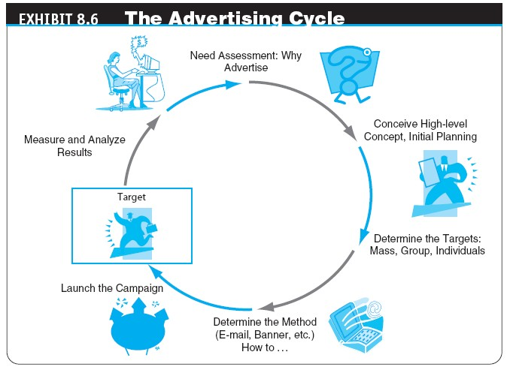

Slide 29
Web Advertising
SOME BASIC INTERNET ADVERTISING TERMINOLOGY
ad views
The number of times users call up a page that has a banner on it during a specific period; known as impressions or page views
button
A small banner that is linked to a website; may contain downloadable software

Slide 30
Web Advertising
page
An HTML (Hypertext Markup Language) document that may contain text, images, and other online elements, such as Java applets and multimedia files; may be generated statically or dynamically
click (ad click)
A count made each time a visitor clicks on an advertising banner to access the advertiser’s website
CPM (cost per mille, i.e., thousand impressions)
The fee an advertiser pays for each 1,000 times a page
with a banner ad is shown

Slide 31
Web Advertising
conversion rate
The percentage of clickers who actually make a purchase
click-through rate/ratio (CTR)
The percentage of visitors who are exposed to a banner ad and click on it
hit
A request for data from a Web page or file

Slide 32
Web Advertising
visit
A series of requests during one navigation of a website; a pause of a certain length of time ends a visit
unique visit
A count of the number of visitors entering a site, regardless of how many pages are viewed per visit
stickiness
Characteristic that influences the average length of time a visitor stays in a site

Slide 33

Web Advertising
Advertising Online and Its Advantages
Cost
Richness of format
Personalization
Timeliness (being at the right time, fresh and up-to-the-
minute)
Location-based (using Wireless technology and GPS)
Linking
Digital branding (nhãn hiệu h{ng hóa, Amazon.com)
Traditional Versus Online Advertisement

Slide 34
Online Advertising Methods
MAJOR CATEGORIES OF ADS
Classified Ads (usually use text, may include photos)
Display Ads (graphics, logos, colors, special designs)
Interactive Ads (video content)
banner
On a Web page, a graphic advertising display linked to the advertiser’s Web page
keyword banners
Banner ads that appear when a predetermined word is
queried from a search engine

Slide 35
Online Advertising Methods
random banners
Banner ads that appear at random, not as the result of the user’s action
live banners (even update in real time)
A banner ad that is created dynamically (or whose content is created dynamically) at the time of display, instead of being preprogrammed with fixed content
Benefits and Limitations of Banner Ads

Slide 36
Online Advertising Methods
pop-up ad
An ad that appears in a separate window before, after, or during Internet surfing or when reading e-mail
pop-under ad
An ad that appears underneath the current browser window, so when the user closes the active window the ad is still on the screen

Slide 37
Online Advertising Methods
e-mail marketing
A form of direct marketing which uses e-mail as a means of communicating commercial messages to an audience
e-mail advertising
Adding advertisements to e-mail messages sent to customers
The Major Advantages and Limitations of E-Mail Advertisement
Implementing E-Mail Advertising

Slide 38

Exercises: Create a mailing list
Groups.yahoo.com
Topica.com
Give an example of Fraud email related to credit card

Slide 39

Online Advertising Methods
search advertising
A method of placing online advertisements on Web pages that show results from search engine queries
URL Listing
Keyword Advertising
search engine optimization (SEO)
The craft of increasing site rank on search engines; the optimizer uses the ranking algorithm of the search engine (which may be different for different search engines) and best search phrases, and tailors the ad accordingly

Slide 40
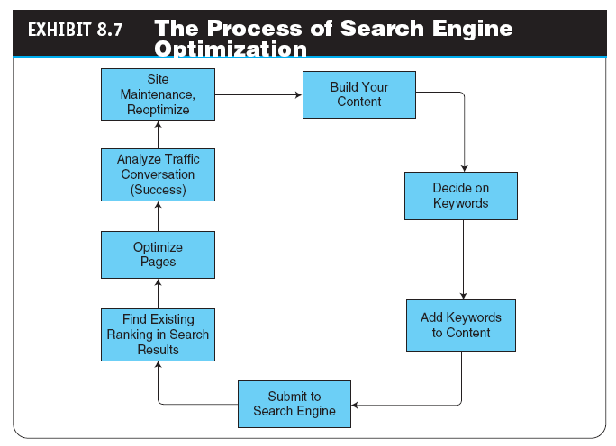

Slide 41
Online Advertising Methods
GOOGLE: THE ONLINE ADVERTISING KING
Google’s Major Advertisement Methods: AdWords and AdSense
viral marketing (viral advertising)
Word-of-mouth marketing by which customers promote a product or service by telling others about it

Slide 42

Online Advertising Methods
VIDEO ADS
Consumer-Generated Videos
interactive video
A technique used to blend user interaction and videos
viral video
A video clip that gains widespread popularity through the process of Internet sharing, typically through e-mail or IM messages, blogs, and other media-sharing websites

Slide 43
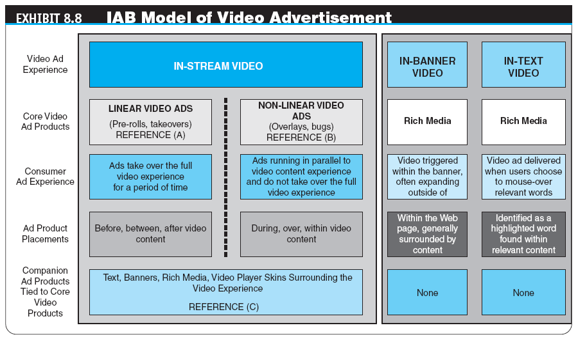

Slide 44
Online Advertising Methods
advergaming
The practice of using computer games to advertise a product, an organization, or a viewpoint
augmented reality (AR)
A live direct or indirect view of a physical, real-world environment whose elements are augmented by computer-generated sensory input, such as sound or graphics
ADVERTISING IN CHAT ROOMS AND FORUMS

Slide 45
Exercises: Advergaming
https://itmanagerduels.intel.com/en_us/Tutorial (an example of Intel’s website)

Slide 46
Mobile Marketing and Advertising
mobile marketing
Conducting marketing on or with a mobile device
mobile advertising (m-advertising)
Ads sent to and presented on mobile devices
Mobile Interactive Advertising
Types of Mobile Ads
Viral Mobile Marketing
Mobile Marketing and Advertising Campaigns
Representative Examples of Mobile Advertising

Slide 47
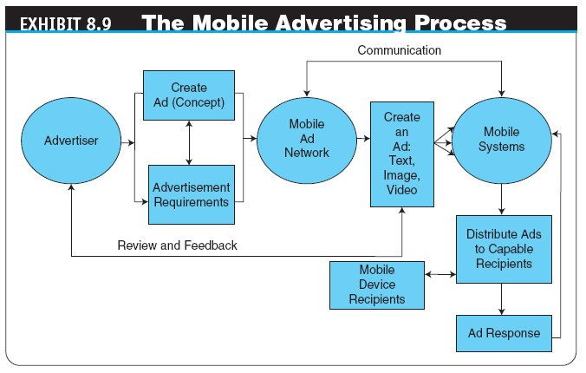

Slide 48
Mobile Marketing and Advertising
MOBILE MARKETING IMPLEMENTATION GUIDELINES
Notice
Choice and consent (respecting)
Customization and constraint
Security
Enforcement and accountability (MM Association)
TOOLS TO SUPPORT MOBILE ADVERTISEMENT
MOBILE AD TRENDS

Slide 49
Advertising
Strategies and Promotions
spamming
Using e-mail to send unwanted ads (sometimes floods of ads)
permission advertising
Advertising (marketing) strategy in which customers agree to accept advertising and marketing materials (known as opt-in)

Slide 50
Advertising
Strategies and Promotions
OTHER ADVERTISING STRATEGIES
affiliate marketing
A marketing arrangement by which an organization refers consumers to the selling company’s website
affiliate network
A network that acts as an intermediary between publishers (affiliates) and merchant affiliate programs
Ads as a Commodity (Paying People to Watch Ads)
Mypoints.com, click-rewards.com
Selling Space by Pixels
http://milliondollarhomepage.com/

Slide 51
Advertising
Strategies and Promotions
Personalized Ads
Webcasting
A free Internet news service that broadcasts personalized news and information, including seminars, in categories selected by the user
Ad Exchanges
Advertisement as a Revenue Model
pay per click (PPC)
A popular Internet advertising payment model where
advertisers pay their host only when the ad is clicked on
Choose-Your-Own-Ad Format

Slide 52
Advertising
Strategies and Promotions
ONLINE EVENTS, PROMOTIONS, AND ATTRACTIONS
Live Web Events for Advertising
localization
The process of converting media products developed in one environment (e.g., country) to a form culturally and linguistically acceptable in countries outside the original target market
INTELLIGENT AGENTS APPLICATIONS
DEVELOPING AN ONLINE ADVERTISING PLAN

Slide 53
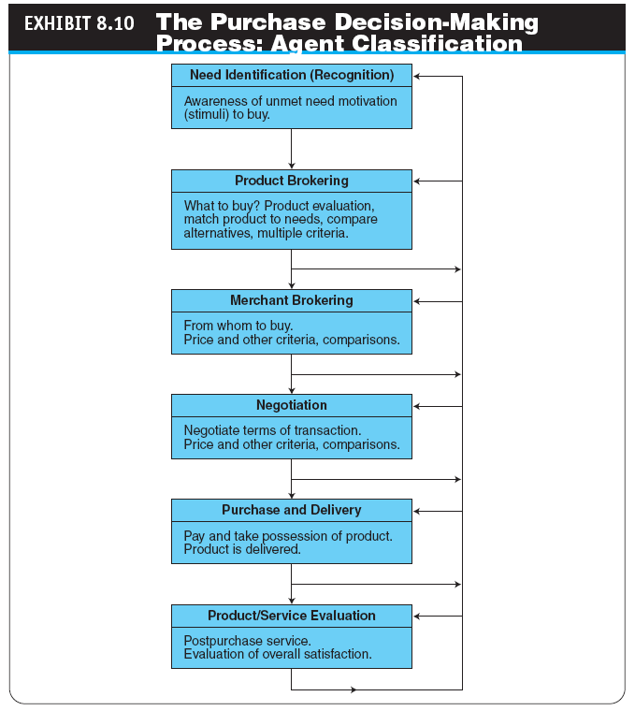

Slide 54

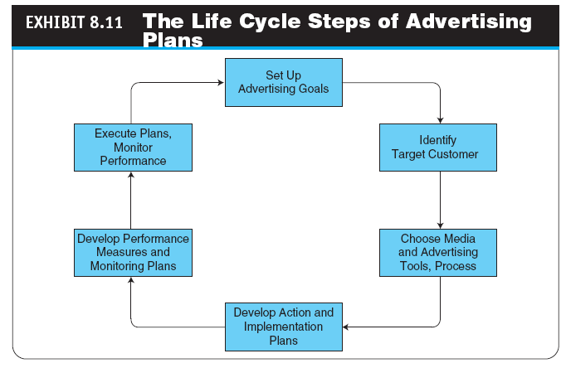

Slide 55
Managerial Issues
Do we focus on value-creating customers?
Which Internet marketing/advertising channel do we use?
What metrics do we use to guide advertisers?
What is our commitment to Web advertising?
Should we integrate our Internet and non-Internet marketing campaigns?
Who will conduct the market research?
Should we use intelligent agents?
Should we use mobile coupons?
What ethical issues should we consider in online marketing?

Slide 56
Summary
Factors influencing online consumer behavior
The online consumer decision-making process
Increasing loyalty and trust
Market segmentation and building one-to-one relationships with customers
Online personalization
EC consumer market research
Objectives and characteristics of Web advertising
Major online advertising methods
Mobile Marketing
Various advertising strategies and types of promotions

Slide 57




All rights reserved. No part of this publication may be reproduced, stored in a retrieval system, or transmitted, in any form or by any means, electronic, mechanical, photocopying, recording, or otherwise, without the prior written permission of the publisher. Printed in the United States of America.
Copyright © 2012 Pearson Education, Inc.
Publishing as Prentice Hall

